Slide 1
Google Search Term Analysis Using Natural Language Processing

Slide 2


Background
Data Analyst @ Cerulli Associates
Research and Consulting focused on financial services sector

Slide 3

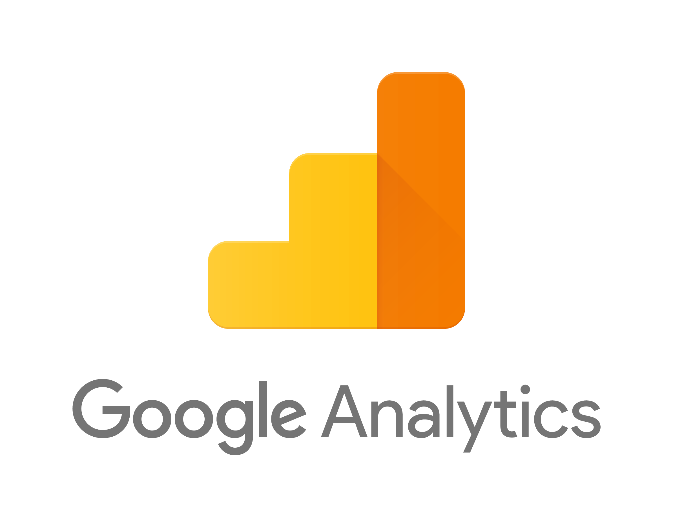

The Problem:
A lot of data, not a lot of insight
Google Analytics
Notes:
The genesis of my project started earlier this year, the marketing team at our company opened up Google Analytics data to the data and analytics team hoping to gain some insight. The marketing team was basically using the data to track simple metrics like email clicks and website traffic. But these metrics didn’t really have any context so they were effectively useless to anyone outside the team.
The data and analytics team had a wide-ranging mandate of using all the google analytics data with the hopes of rolling it into internal reporting and perhaps using it to support more marketing decisionmaking.
Basically, they came to our team saying ‘we have a ton of data and don’t know what to do with it, so go wild’. I didn’t have much experience with Google Analytics and web data so it was a bit overwhelming at first. I was not used to working with data like this and I didn’t really know where to begin.
Then I remember this book I read last year, called ‘Everybody Lies” by Seth Stephens-Davidowitz, who is a big data writer at the New York Times. The book touched on a lot of different data related things, however the overacting theme was about how web data is going to revolutionize social science research. He argues that google searches are one of the best ways of gleaning this insight because people are at their most intellectually vulnerable when posing a question to google, therefore those queries best represented their thinking. The idea of search term analysis was at the front of my mind, and this was exactly the kind of data I had just been handed. Thus the project was born.

Slide 4

The Goal
Using NLP, build a model able to predict whether a search came from an existing user or new user
WHY?
Notes:
WHY:
For the reasons I just mentioned, I believed that there is insight to be had in regards to the traffic coming into our website, and more specifically the search queries that were directing people to the site. As we saw in the NLP module in class, the field is very wide ranging. So I wanted to keep any analysis simple. My hope was that this project was kind of a first step in building out that framework and methodology that will lead into further analysis. I thought that building a model predicting users vs non-users was a simple jumping off point.

Slide 5
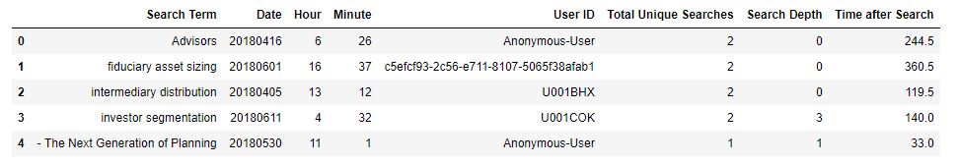
The Data
Quarterly search data from Google Analytics
n = 5,503
Notes:
My dataset was taken from Google Analytics and only encompasses 2Q 2018 searches. There were 5,503 incoming searches from google that quarter. Here is what the headers look like before preprocessing.

Slide 6
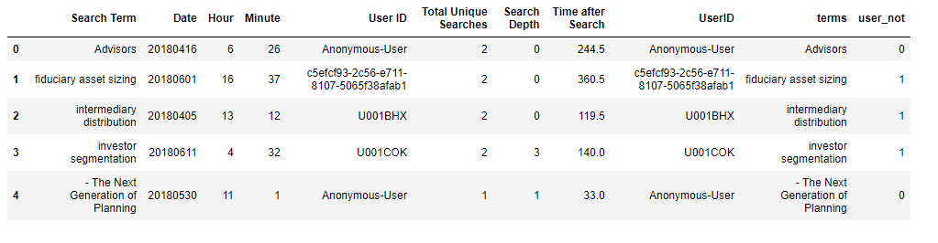

Preprocessing
Changing column names
Creating binary user variable (user_not) which is our target variable
Creating term vectors
Removing stop words and “rubbish” (misspelled words, escape characters)
Notes:
The first part of preprocessing work was making column names more workable and refining the search terms to be easier to work with. I also created a binary ‘user_not’ variable out of the User ID variable. Essentially if the search came in and there was one of these User ID strings, it meant they were an existing user in our system and were assigned a ‘1’. All other anonymous User IDs were assigned a ‘0’. This will be the target variable for all subsequent analysis.
I also created two vectors for the search terms. One was a simple count vector and another was a term frequency inverse document frequency vector, which were the two different vectors we worked with during our NLP unit. It was my hunch that the TF-IDF vector would ultimately be the more accurate vector, however I thought it was important to use both for analysis

Slide 7
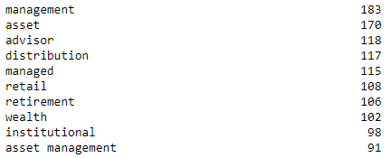
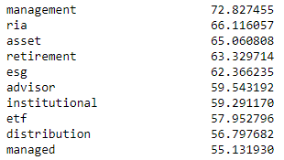
EDA
Less opportunity for visualization and EDA exercises with NLP
Count Vector Top Terms
TF-IDF Vector Top Terms
Notes:
There was not as much opportunity for traditional visualizations working with NLP. I felt it would be kind of useless, for example, to look at a seaborn heat map for a count vector where there are literally thousands of features.
However I did look at how the top terms for each vector type were different. You can see that they are generally the same with a few differences. RIA shoots up to the 2nd most important terms in the corpus in the TF-IDF vector. Other terms like ESG (which stands for Environmental, Social, and Governance. It’s a type of investment strategy that’s kind of in vogue right now). So these terms might not have appeared the most across all terms, but based upon the TF-IDF method of determining importance, they were extremely important.

Slide 8
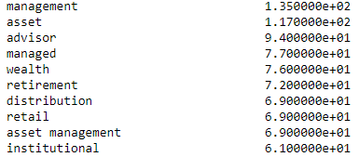
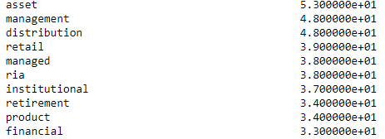
EDA
Top Ten TF-IDF Vector Terms for NONUSERS
Top Ten TF-IDF Vector Terms for USERS
Notes:
Here is a comparison between the top tf-idf vector terms for users vs nonusers. Again many of the terms are similar, but there are also some difference, which I have highlighted in yellow.
One thing that jumps out to me is nonusers using terms like wealth and advisor. We had a report go out last quarter that focused on the evolution of technology in wealth management. It was a new report and I don’t think it’s a stretch to say we had wealth managers specifically seeking this new report.
On the other side, among existing users, the three unique terms are RIA, product, and financial. One of our most popular reports and products is related to financial advisors. RIA is an acronym for Registed Independet Advisor, which is another word for a financial advisor. MY guess is that these folks are looking for our advisor report or advisor database.
So the data was definitely telling a story that fit kind of nicely with my hypothesis that analyzing search terms could help inform why people are coming to our site.

Slide 9
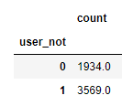


Models
For a baseline model to compare my term vector models, I used a simple percentage of known users
Notes:
So the next step would be to start building my models.
I decided to use a simple percentage of users as the baseline. So that’s to say that any search term that was coming in would be a 64.8% chance that it was from an existing user.

Slide 10
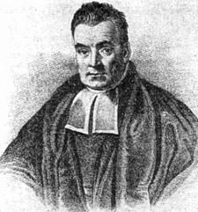
Native Bayes
I used a Native Bayes classification model
Notes:
For all my modelling exercises, I decided to use a Native Bayes classification model.
This being a classification exercise, I was weighing using logistic regression as well. Ultimately I went with Native Bayes because it seemed better suited for the relatively small sample size that I was working with.

Slide 11
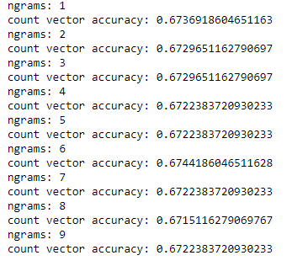

Count Vector Model
This was a simple count vector
Iterated through ngrams and settled on 6
Notes:
I ultimately built three models.
The first was a model utilizing the simple count vector. After training and testing I was able to settle on an accuracy of 67.4%. A slight improvement, however not great.

Slide 12
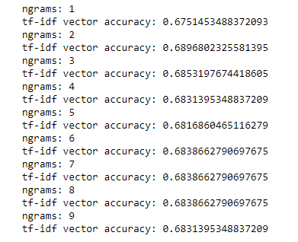
TF-IDF Vector Model
This vector uses the term frequency inverse document frequency vector
Iterated through ngrams and settled on 2
Notes:
The second model was a TF-IDF model. After training and testing this model was able to predict with about a 68.9% accuracy. An improvement, however still not great. And it confirmed my hunch that the TF-IDF model would be more useful in predicting users vs nonusers.

Slide 13
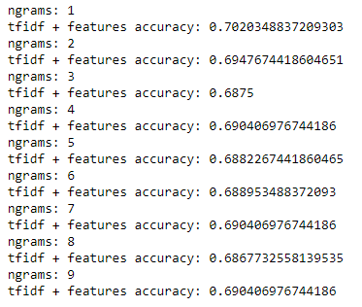
TF-IDF + Features Vector Model
This model uses the TF-IDF vector with added metadata features
Iterated through ngrams and settled on 1
Notes:
The final model I built was similar to the TF-IDF model that also included two other features from the data set: search depth and time after search. Search depth indicates how many clicks the searcher had on our site after their google search. Time after search is simply how much time, in seconds, they spent on our site after being redirected via search.
This model was able to predict users with a 70.2% accuracy.

Slide 14


Model comparison
The winner: TF-IDF + Features
Notes:
The tfidf plus features model was the winner, and was able to predict users about 5.5% better than the baseline model. So not a huge improvement, but its improvement.
Moving forward I would like to incorporate more features into the tf-idf model beyond search depth and time after search. One route that I think might be interesting is using time series analysis. Our company produces reports and research on a relatively predicable cycle, and I think it would be interesting to see how this seasonality might improve the model. This would involve a more large scale analysis that would go beyond a quarter by quarter basis. I would probably need a couple years of data and at this point we only have about 6 months of search term data.
Unfortunately the model in its current form the accuracy isn’t impeccable and I wouldn’t feel super comfortable using it for large scale analysis or something client-facing, but I think it serves as a kind of a neat demo as to the potential insights search terms might have. And maybe as we accumulate more data the model will become more accurate.
However the first part of my EDA, which was identifying the differences in search terms between new and existing users, is going to be part of our quarterly internal reporting moving forward, and my hope is that eventually we can use this search term analysis to make better decisions regarding our report marketing strategy.

Slide 15
The End!

